Slide 1
Atelier B5 Marie Petráková

Slide 2
Suché prostředí
ČÍSLO | NÁZEV | KVETENÍ (BARVA) |  |  |  |  |  |  |  |  |  |  |  | VÝŠKA
 |  | I. | II. | III. | IV. | V. | VI. | VII. | VIII. | IX. | X. | XI. | XII.
1 | Amorpha fruticosa |  |  |  |  |  |  |  |  |  |  |  |  | 1 - 3 m
2 | Amygdalus nana |  |  |  |  |  |  |  |  |  |  |  |  | 1 - 1.5 m
3 | Echinacea purpurea 'Green Jewel' |  |  |  |  |  |  |  |  |  |  |  |  | 60-70 cm
4 | Echinacea purpurea 'Magnus' |  |  |  |  |  |  |  |  |  |  |  |  | 90-100 cm
5 | Stachys byzantina 'Lamb's Ears' |  |  |  |  |  |  |  |  |  |  |  |  | 30-40 cm
6 | Sedum sunsparkler ' Blue Pearl' |  |  |  |  |  |  |  |  |  |  |  |  | 40 cm
7 | Thymus serpyllum 'September' |  |  |  |  |  |  |  |  |  |  |  |  | 5 -10 cm
8 | Euphorbia amygdaloides 'Purple' |  |  |  |  |  |  |  |  |  |  |  |  | 30-40 cm
9 | Geranium x Cantabrigense 'Cambridge' |  |  |  |  |  |  |  |  |  |  |  |  | 20-30 cm
l | Sanguisorba |  |  |  |  |  |  |  |  |  |  |  |  | 50-80 cm
„Babiččina prérie“

Slide 3
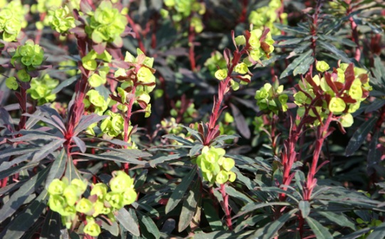
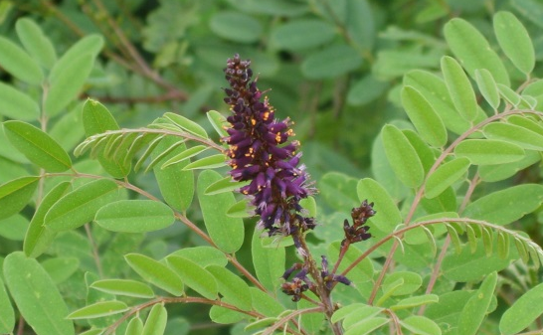
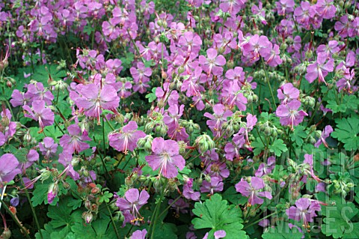
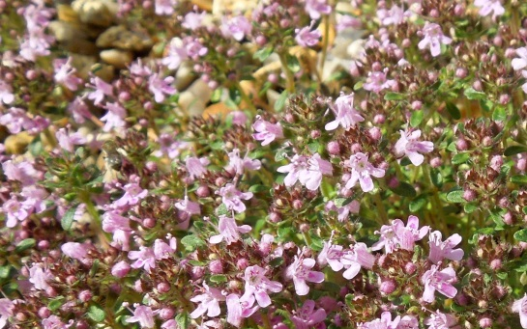
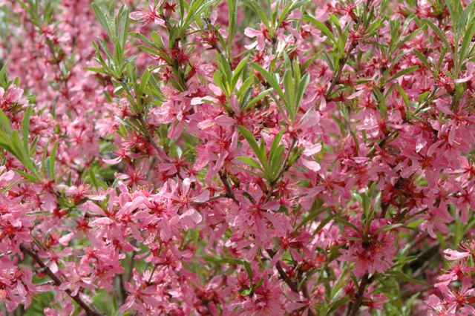
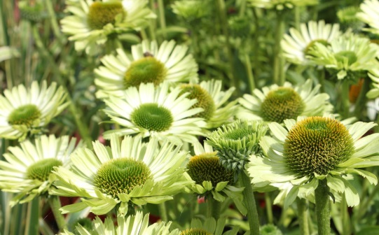
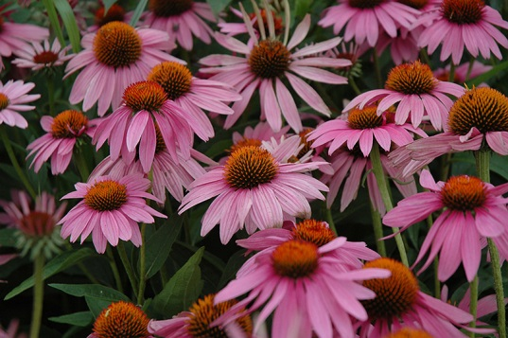
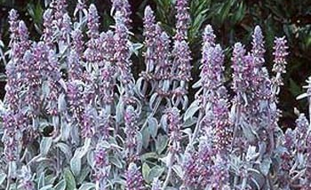
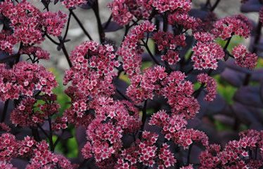

Slide 4
Bukový výškový stupeň
ČÍSLO | NÁZEV | KVETENÍ /PLODY /BARVA |  |  |  |  |  |  |  |  |  |  |  | VÝŠKA
 |  | I. | II. | III. | IV. | V. | VI. | VII. | VIII. | IX. | X. | XI. | XII.
1 | Crataegus laevigata |  |  |  |  |  |  |  |  |  |  |  |  | 2-4m
2 | Malus floribunda |  |  |  |  |  |  |  |  |  |  |  |  | 3-5 m
3 | Sambucus racemosa |  |  |  |  |  |  |  |  |  |  |  |  | 1.5 - 3 m
4 | Berberis thunbergii 'Atropurpurea' |  |  |  |  |  |  |  |  |  |  |  |  | 80-90 cm
5 | Caluna vulgaris 'Firefly' |  |  |  |  |  |  |  |  |  |  |  |  | 20-30cm
6 | Cotoneaster horizntalis |  |  |  |  |  |  |  |  |  |  |  |  | 30-50 cm
7 | Gaultheria procumbens |  |  |  |  |  |  |  |  |  |  |  |  | 15-20 cm
8 | Berberis thunbergii 'Aurea' |  |  |  |  |  |  |  |  |  |  |  |  | 60-80 cm
9 | Hedera helix 'Goldheart' |  |  |  |  |  |  |  |  |  |  |  |  | plazivý
10 | Hedera helix 'Gold child' |  |  |  |  |  |  |  |  |  |  |  |  | plazivý
„Hořící keř“

Slide 5
